Slide 1


Function, Series
Noshin Nawar
Instructor, Phoenix Admission Care

Slide 2
Today we will learn about:
Function:
Independent & dependent variable
What is function?
Value of function
Composite function
Inverse function
Series:
Arithmetic & Geometric Series
Some common series
Non-Arithmetic & Non-Geometric Series

Slide 3
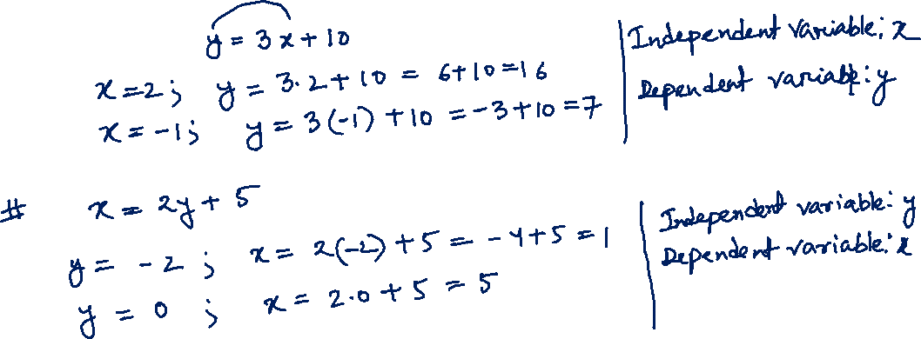
Function
Independent and dependent variable

Slide 4
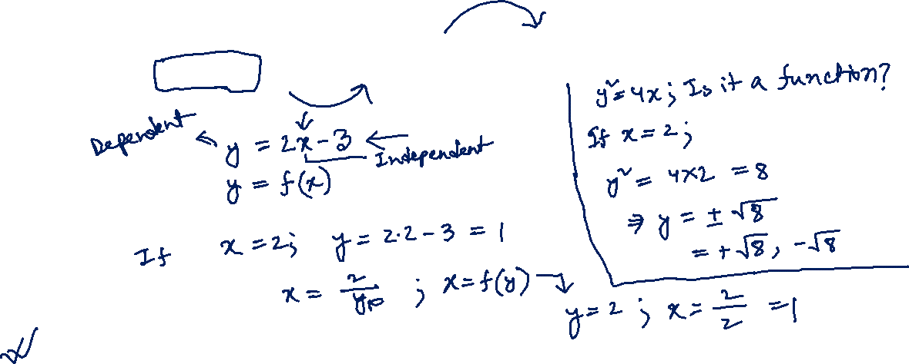
What is Function?
A function describes a relationship where each input (independent variable) is associated with exactly one output (dependent variable).
Function will always be for independent variable.

Slide 5
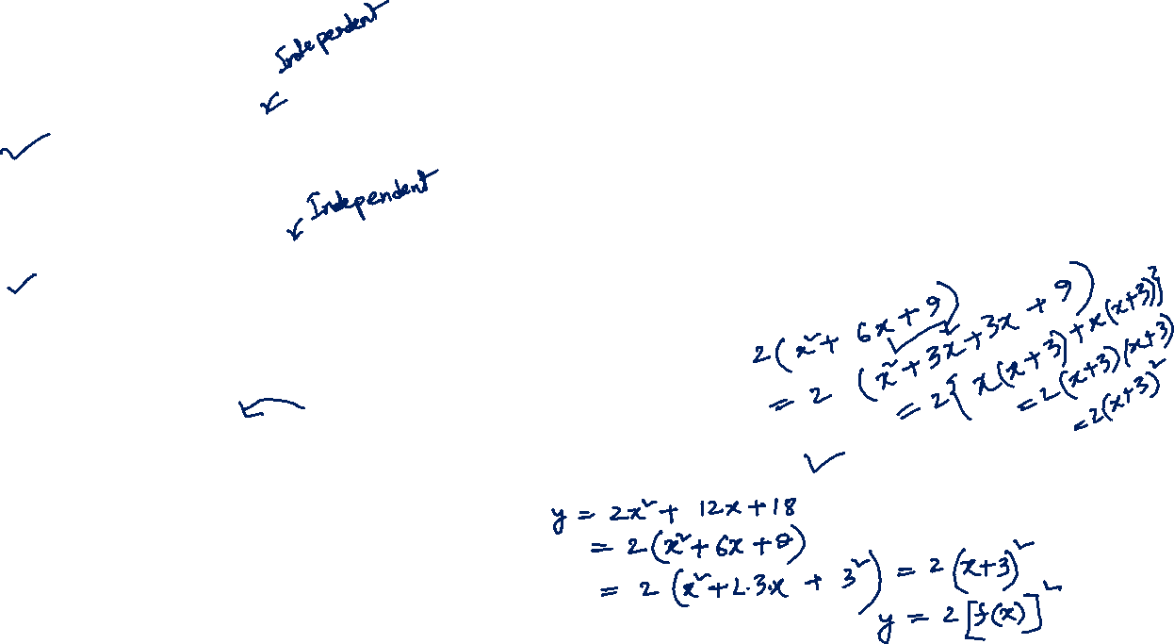
Practice Problem: y = 3x – 5 is a function of:
a. x b. y c. both d. none
Practice Problem: If x = 6y + 11 then which one of the following is true?
a. x =f(y) b. y = f(x) c. both d. none
Practice Problem: If f(x) = x + 3 and y = 2x² + 12x + 18, then the relationship between y and f(x) is:
a. y = 2f(x) b. y² = f(x)² c. f(x) = $\sqrt{y}$ d. y = 2[f(x)]² e. none

Slide 6
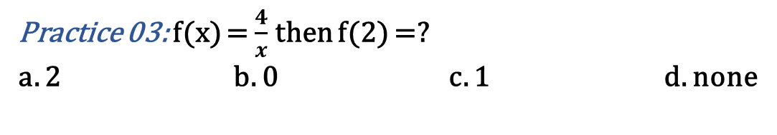
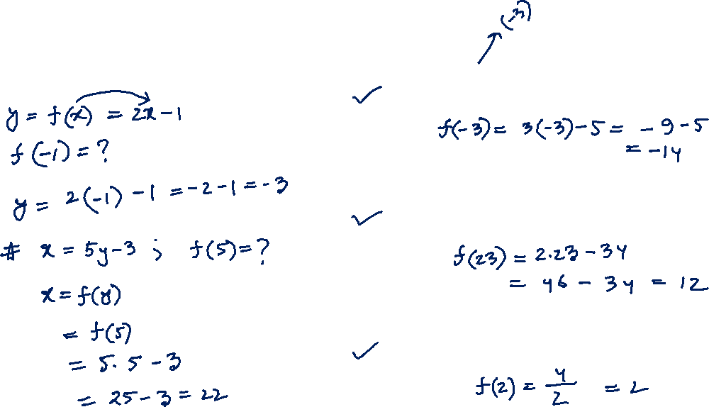
Value of Function
Practice 01: f(x) = 3x – 5 then f(–3) =?
a. –14 b. 5 c. 2 d. 45
Practice 02: f(y) = 2y – 34 then f(23) =?
a. 12 b. 2 c. 21 d. 48
Practice 03: f(x) = $\frac{4}{x}$ then f(2) =?
a. 2 b. 0 c. 1 d. none

Slide 7
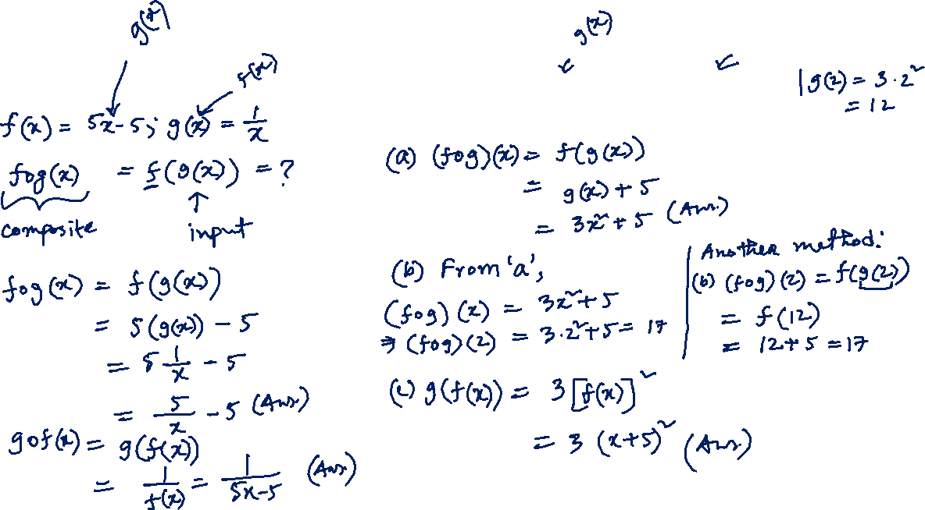
Composite Function
Practice: If f(x) = x + 5 and g(x) = 3x² find:
(a) (fog)(x) (b) (fog)(2) (c) g(f(x))

Slide 8
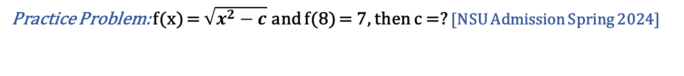
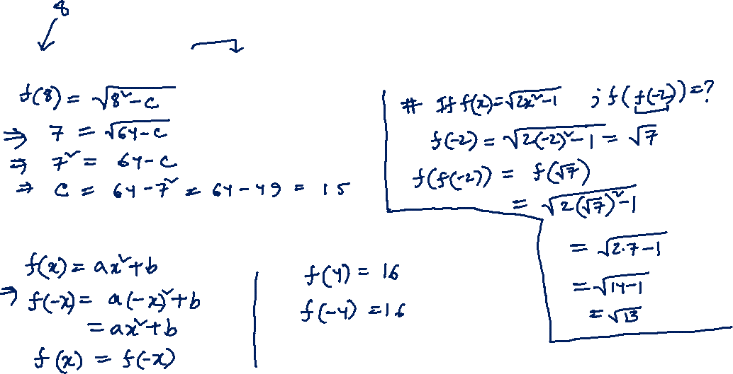
Practice Problem: f(x) = $\sqrt{x^{2}−c}$ and f(8) = 7, then c =? [NSU Admission Spring 2024]
Practice Problem: f(x) = ax² + b and f(4) = 16 then f(-4) =? [NSU Admission Fall 2022]

Slide 9
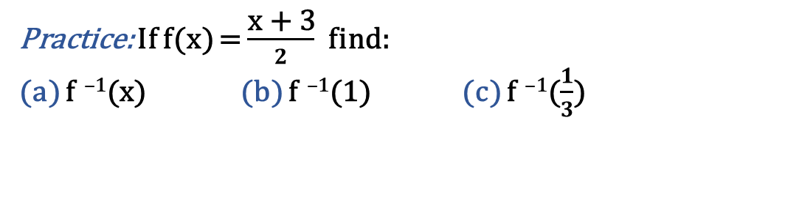
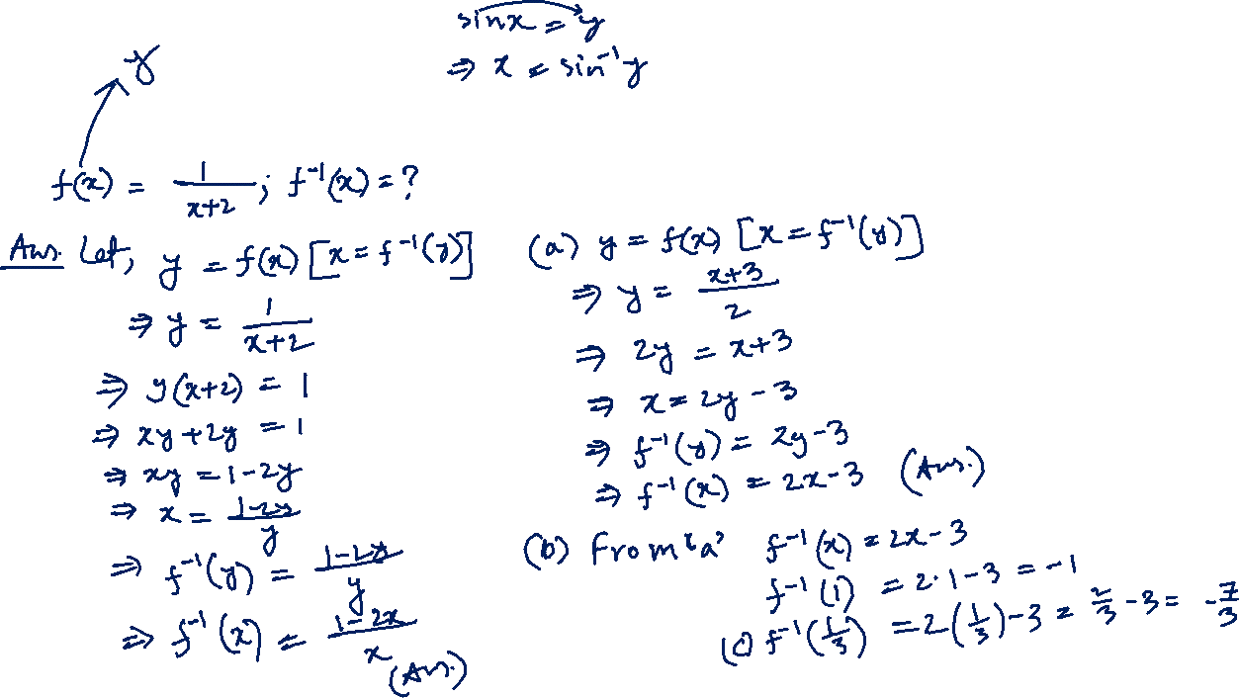
Inverse Function
Practice: If f(x) = $\frac{\text{x}\text{ + 3}}{2}$ find:
(a) f ^{–1}(x) (b) f ^{–1}(1) (c) f ^{–1}($\frac{1}{3}$)

Slide 10
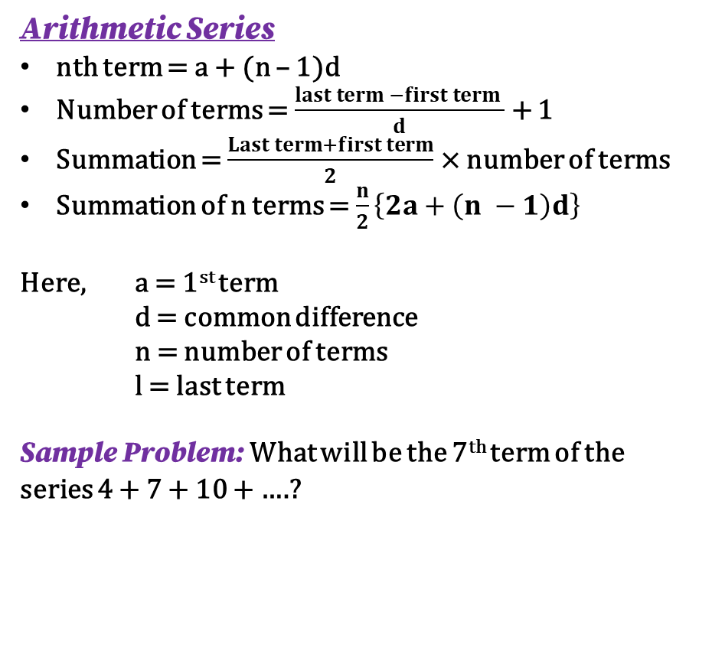
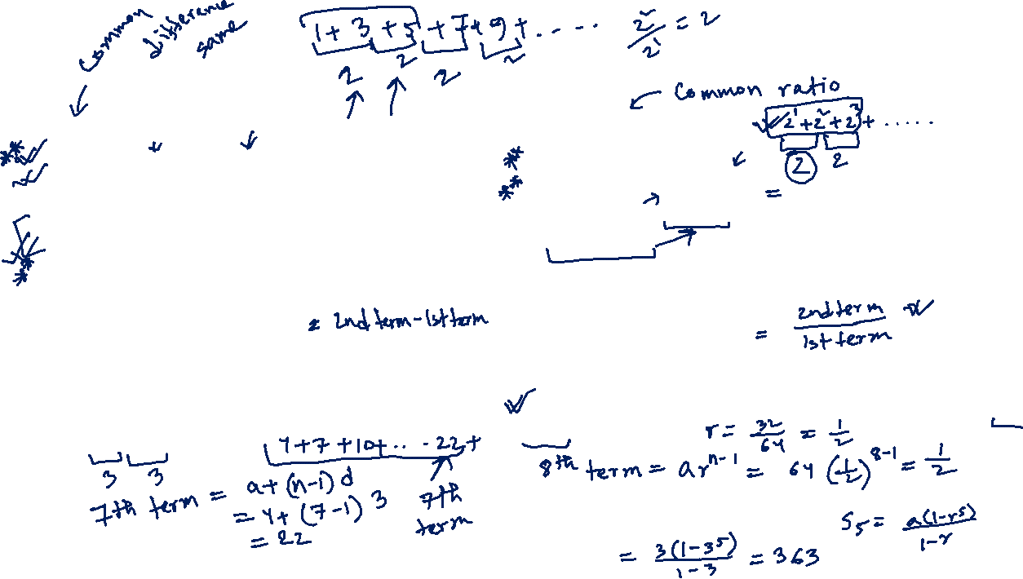
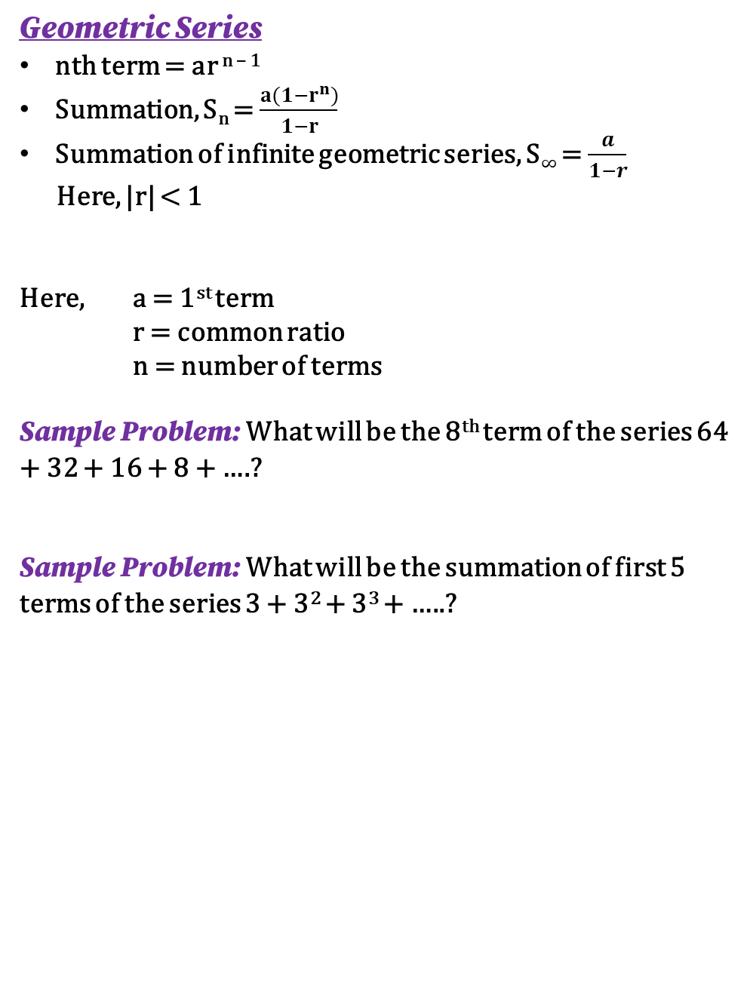
Series
Arithmetic Series
nth term = a + (n – 1)d
Number of terms = $\frac{last term −first term }{d}$ + 1
Summation = $\frac{Last term+first term}{2}$ × number of terms
Summation of n terms = $\frac{n}{2}\left\{2a+\left(n −1\right)d\right\}$
Here, a = 1st term
d = common difference
n = number of terms
l = last term
Sample Problem: What will be the 7th term of the series 4 + 7 + 10 + ….?
Geometric Series
nth term = ar ^{n – 1}
Summation, S_{n} = $\frac{a(1−r^{n})}{1−r}$
Summation of infinite geometric series, S$∞$ = $\frac{a}{1−r}$
Here, |r| < 1
Here, a = 1st term
r = common ratio
n = number of terms
Sample Problem: What will be the 8th term of the series 64 + 32 + 16 + 8 + ….?
Sample Problem: What will be the summation of first 5 terms of the series 3 + 3² + 3³ + …..?

Slide 11
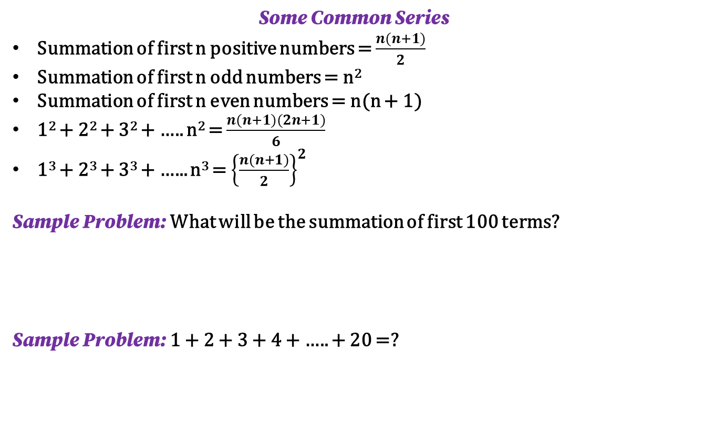
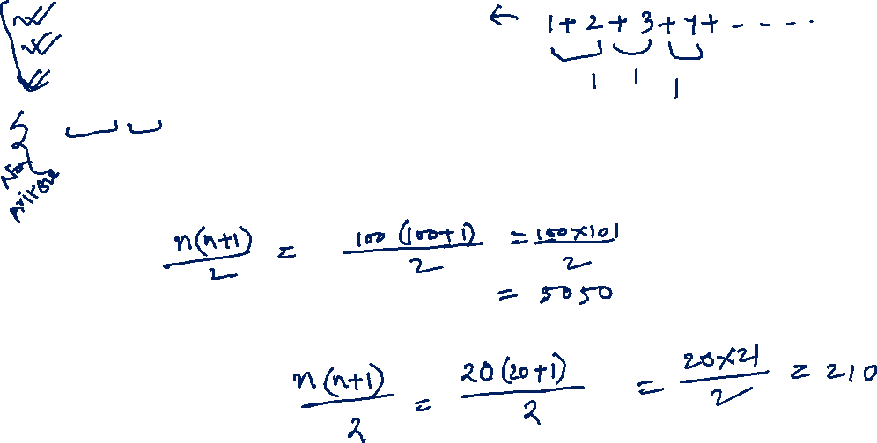
Some Common Series
Summation of first n positive numbers = $\frac{n(n+1)}{2}$
Summation of first n odd numbers = n²
Summation of first n even numbers = n(n + 1)
1² + 2² + 3² + ….. n² = $\frac{n(n+1)(2n+1)}{6}$
1³ + 2³ + 3³ + …... n³ = ${\left\{\frac{n(n+1)}{2}\right\}}^{2}$
Sample Problem: What will be the summation of first 100 terms?
Sample Problem: 1 + 2 + 3 + 4 + ….. + 20 =?

Slide 12
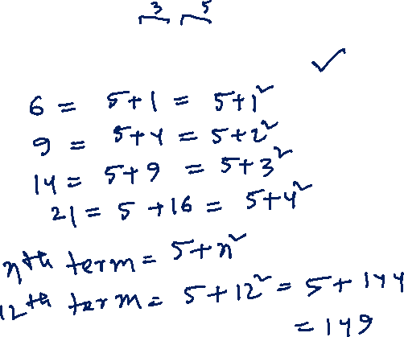
Some Non-Arithmetic and Non- Geometric Series
You have to find out the pattern and nth term by observing the series
Sample Problem: What is the 12th term of the series 6 + 9 + 14 + 21 + …? [NSU Admission Spring 2024]
a. 101 b. 104 c. 95 d. 104 e. 149

Slide 13
Any Question?

Slide 14
Thank you for joining.

